Slide 1
INTEGRATING EQUIP IN PEER COUNSELLOR TRAINING
A National, Peer-led Approach to Integrating HIV and Mental Health for Children, Adolescents and Young People living with HIV

Slide 2
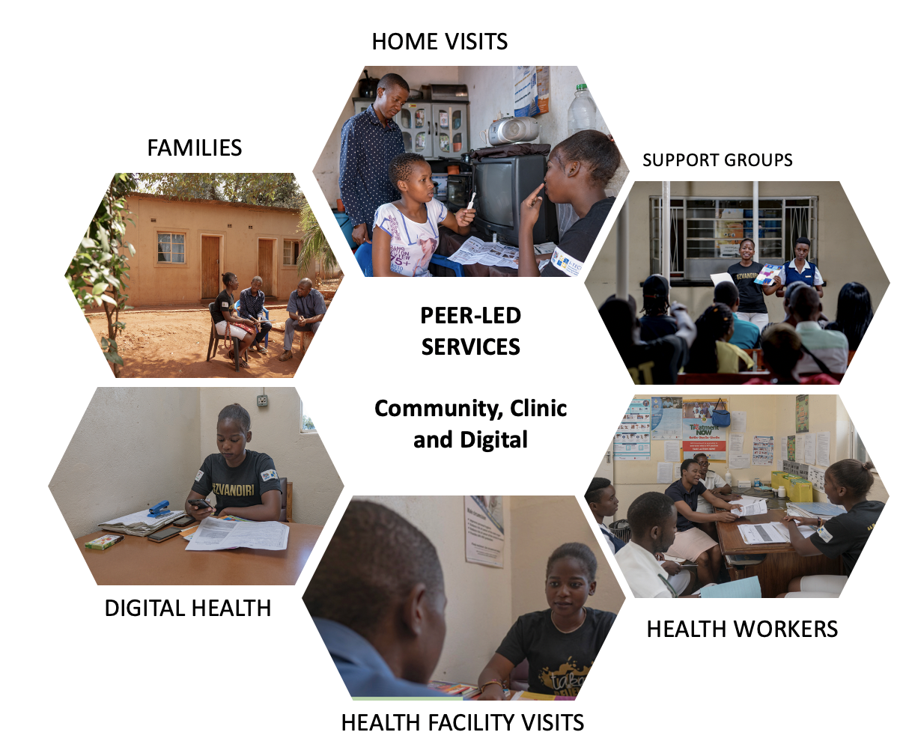
DIRECT SERVICE WORKFORCE: PEER COUNSELLORS
Community Adolescent Treatment Supporters (CATS)
and Young Mentor Mothers (YMMs)
Notes:
Task –sharing to meet the needs of CATALHIV

Slide 3
WHO THE PEER COUNSELLORS ARE
Criteria
HIV positive 18-24 yr olds
On ART; adhering well
Willing to engage as a CATS
Good soft skills, leadership skills
Able to read and write
Out of school (position should not interrupt school
Consent from caregivers
CATS selection is a joint process conducted by the IP & Health Care Worker (HCW) under supervision of the Nurse in Charge

Slide 4
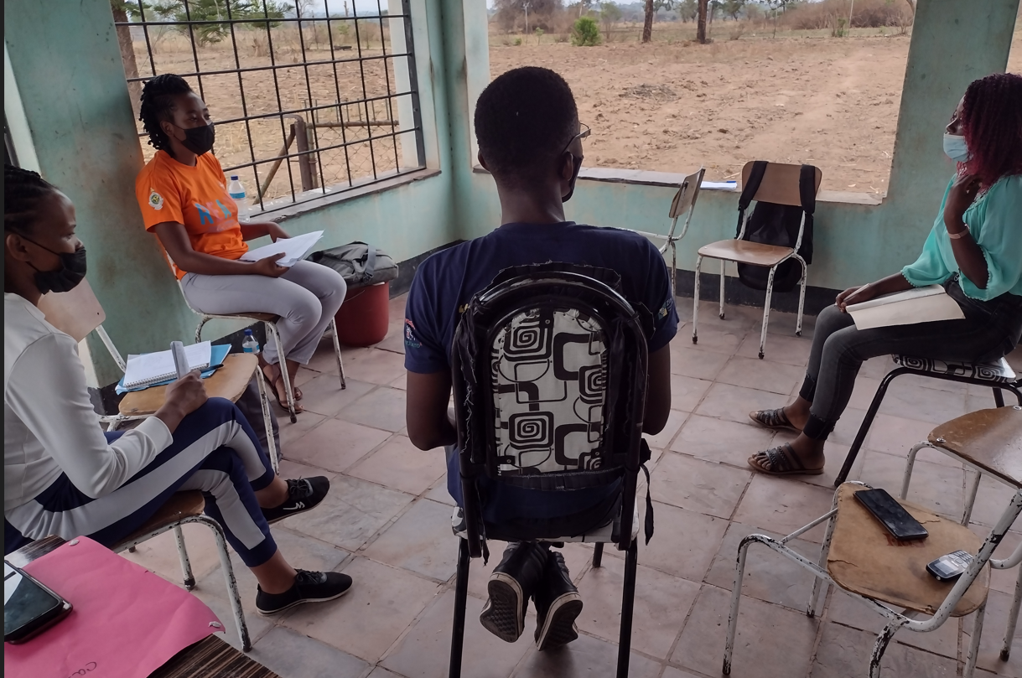
RECRUITMENT, TRAINING AND SUPERVISION
One to Four trained and supported CATS at each clinic
CATS are selected and recruited by Zvandiri and Ministry of Health and Child Care (MoHCC)
One week training and clinic attachment for new CATS; facilitated by Zvandiri and MoHCC using a standardised curriculum
Weekly supervision meetings at the clinic with a designated nurse or counsellor
On site mentorship visits from a Zvandiri Mentor located in the district
Bi-monthly/quarterly mentorship at CATS Coordination meetings (varies by funding/grant)

Slide 5
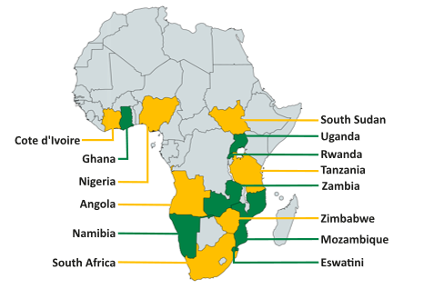
SCALING ZVANDIRI
3,000 peer counsellors
Supporting
90,000 CAYALHIV
Notes:
Need for maintaining quality

Slide 6
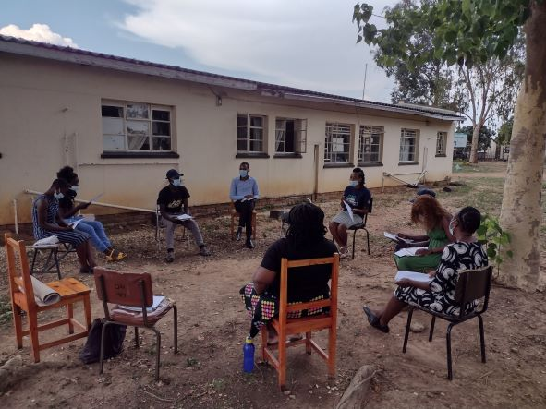
THE NEED TO ENSURE QUALITY
Challenges:
Large cohort of young counsellors covering a vast number of regions/ countries/cultures/settings
Ensuring quality of care
Adequate support to peer counsellors
Limited resources for training ($)
Notes:
High volume of information related to in initial training, 1 day on counselling skills and mental health
Counselling skills aren’t learned in 1 off training

Slide 7
WHAT is EQUIP?
Ensuring Quality in Psychological Support (EQUIP)
World Health Organization and UNICEF’s joint project to support quality in the delivery of psychosocial and mental health services.
Aimed at trained, non-professional care providers, e.g. peer counsellors
For trainers and supervisors to improve the quality of their workers' helping skills and reduce potential harm
EQUIP competency assessment tools focus on assessing demonstrated skills;
help inform trainers and supervisors on their trainees’ progress and areas where they need more practice.
www.equipcompetency.org
Notes:
EQUIP resources have been tested in Ethiopia, Jordan, Kenya, Lebanon, Nepal, Peru, Uganda and Zambia with the results demonstrating training improvements in groups that used the EQUIP platform.
use of EQUIP in Lebanon with children and adolescents led to an increase in mastery of core helping skills compared to standard training approaches.

Slide 8
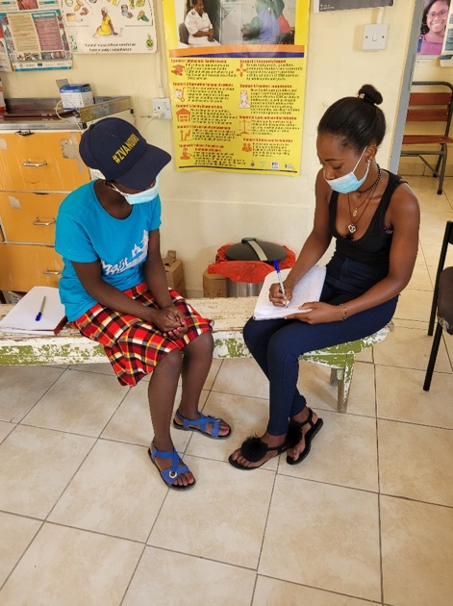
WHO – UNICEF EQUIP
ENACT (adult assessment tool)
Foundational helping competencies include those related to building a warm, trustworthy relationship between the helper and client, building rapport, using verbal and non-verbal communication skills, demonstrating empathy and genuineness, and working collaboratively with the client.
WeACT (child assessment tool)
A foundational competencies assessment tool tailored for helpers and educators delivering care to children and adolescent populations in the Child Protection, Education and Mental Health and Psychosocial Support sector.

Slide 9
PROJECT APPROACH
Zvandiri partnered with Zimbabwe’s WHO Special Initiative on Mental Health to test integration of EQUIP into a CATS training
With the support of WHO, developed a hybrid of EQUIP assessment tools, ENACT and WeACT, to align with Zvandiri’s population (CATS ages 18 – 24, counselling all ages up through 24 years)

Slide 10
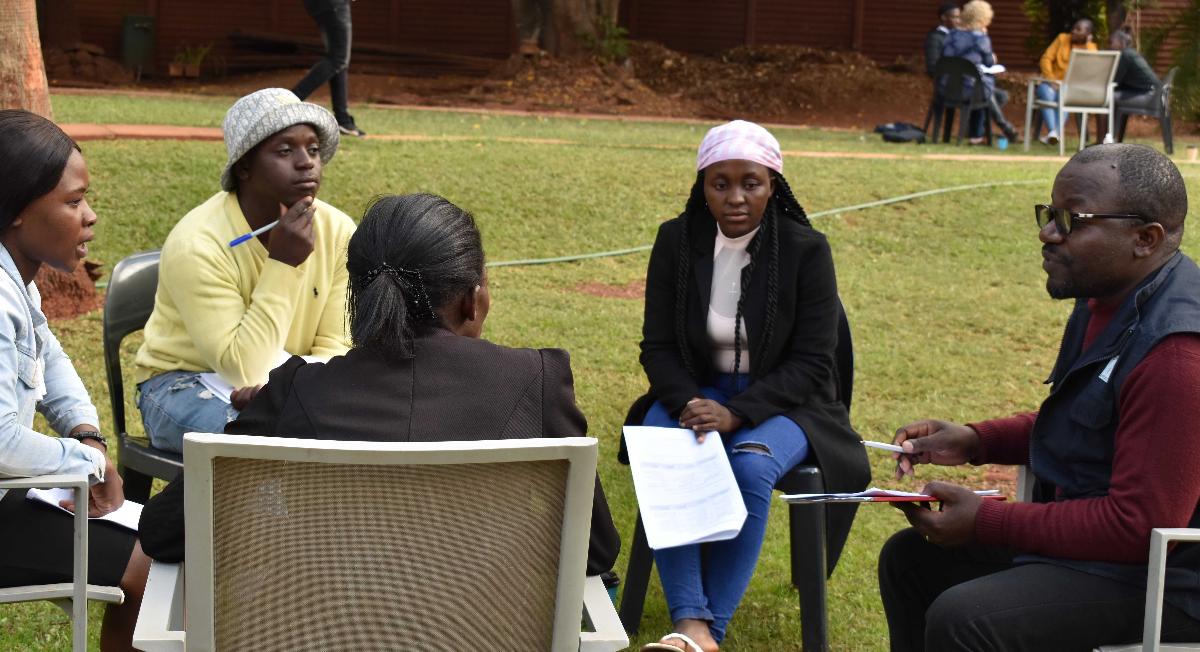
PLANNING – HYBRID TOOL, 14 COMPETENCIES
ENACT, 10 competencies
Non-verbal communication & active listening
Verbal communication skills
Explanation & promotion of confidentiality
Rapport building & self-disclosure
Exploration & normalisation of feelings
Exploration of client's & social support network's explanation for problem (causal & explanatory models)
Appropriate involvement of family members & other close persons
Promotion of realistic hope for change
Incorporation of coping mechanisms & prior solutions
Psychoeducation & use of local terminology
WeACT
Empathy, warmth & genuineness
Safe identification of child abuse, exploitation, neglect, violence, & self-harm
Giving feedback to the child
Acknowledges & promotes child’s agency in the session
Notes:
ENACT
Assessment of harm to/from others (went with WeACT – child protection language)
Connection to social functioning & impact on life (more adult language/focus)
Collaborative goal setting -(skip ENACT, collaborative goal setting… more clinically oriented language, CATS aren’t always working problem focused and setting ‘treatment plans’)
Elicitation of feedback
WeAct-
empathy, warmth & genuineness (also in ENACT) –child wording more in line with CATS work/our population- ENACT asks for labling (basic skills) of and reflection on specific feelings (advanced skills) that would be difficult for mid adolescents and younger. Not over promising in WeACT is important (advanced skills
Safe ID etc, Instead of ENACT #7 Assessment of Harm to self, others, from others, and developing a collaborative plan- wording better for children and ado with focus, discusses assent, possible referral, management of a child’s expectations)

Slide 11
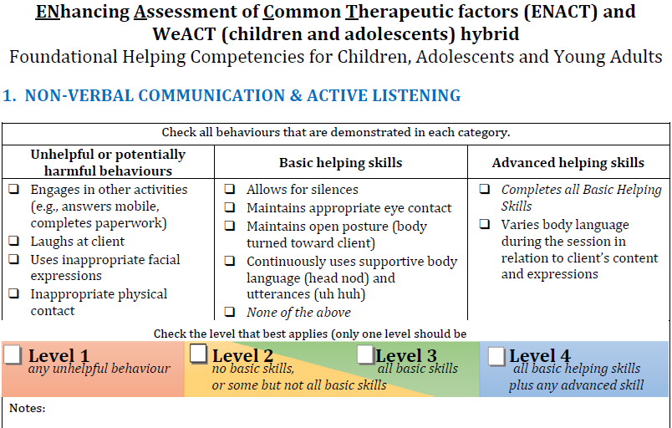
SAMPLE COMPETENCY

Slide 12
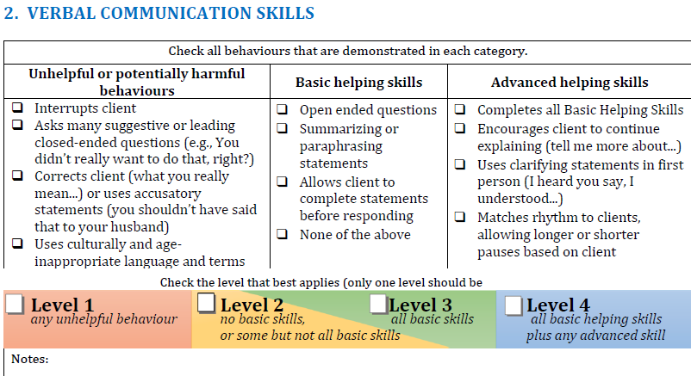
Describe ENACT / WeACT

Slide 13
PROCESS
16 CATS from Harare who needed to strengthen their counselling skills and confidence and selected them for participation
The standard (5 day) CATS training was run
Baseline established at start of the training
CATS divided into groups of 4 for roleplays, each with 1 facilitator
Groups ran 4 roleplays with each person roleplaying a CATS once (video taped)
After each role play, facilitator scored the competencies
Feedback given after all 4 roleplays were completed
More opportunities for roleplaying and feedback during the training
Same process for midline and endline assessments

Slide 14
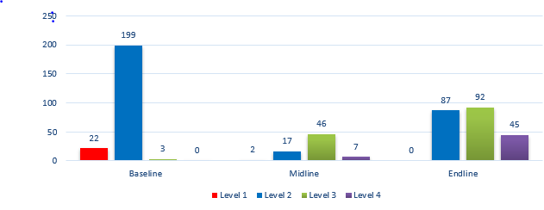
SUMMARY OF THE 14 COMPETENCIES
Notes:
At baseline, CATS primarily demonstrated foundational level 2 skills, but also some unhelpful or potentially harmful behaviours. 12 of the 16 CATS demonstrated 1 – 3 unhelpful behaviours each, with a total of 22 unhelpful behaviours observed.

Slide 15
DIFFICULTIES AT BASELINE
Difficulties:
Interrupting
Asking leading questions
Gives unrealistic expectations
Minimizes or dismisses client’s feelings
Ignores emotional responses (1)
Notes:
Also: 3- confidentiality- promises without exception (1)
4- rapport and self disclosure – minimizes client by describing how helper managed theirs (2)
6- empathy and warmth- ignores emotional responses (2)
7 –safety – explores in an intrusive manner (1)
11. Hope for change- gives unrealistic expectations (2)
12. Coping mechanisms – shows acceptance of harmful coping mechanisms (1)
13. Psychoed- uses technical terms without checking understanding (1)
The unhelpful behaviours were predominantly related to clients’ expression of distress, to which the CATS responded by quickly offering unrealistic hope, e.g. ‘you’ll be fine’, ‘you won’t die from HIV’ (attempting to sooth a client upset that she might die from HIV the way her mother did), or minimizing feelings, ‘don’t worry, everything will be ok.’ (to a client upset about status and another upset after a girlfriend ended the relationship upon learning of the client’s positive HIV status).
Explanation of confidentially (1); empathy, ignore emotional responses, 1 safety; 1 coping; 1 terminology; 1 promotes agency

Slide 16
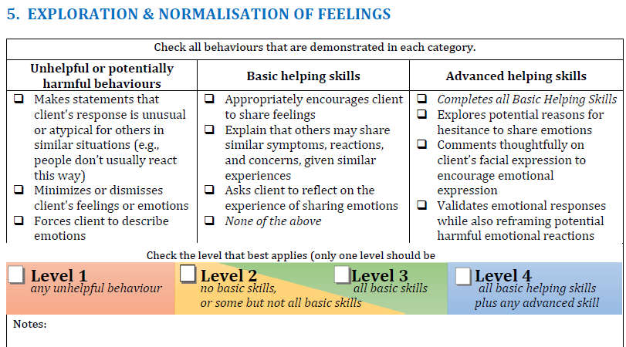
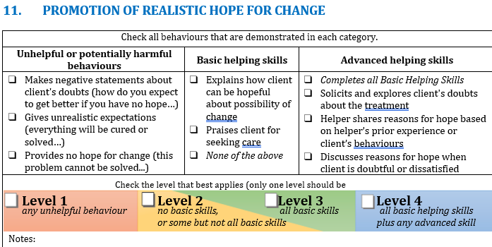
SAMPLE: CHALLENGES AT BASELINE

Slide 17
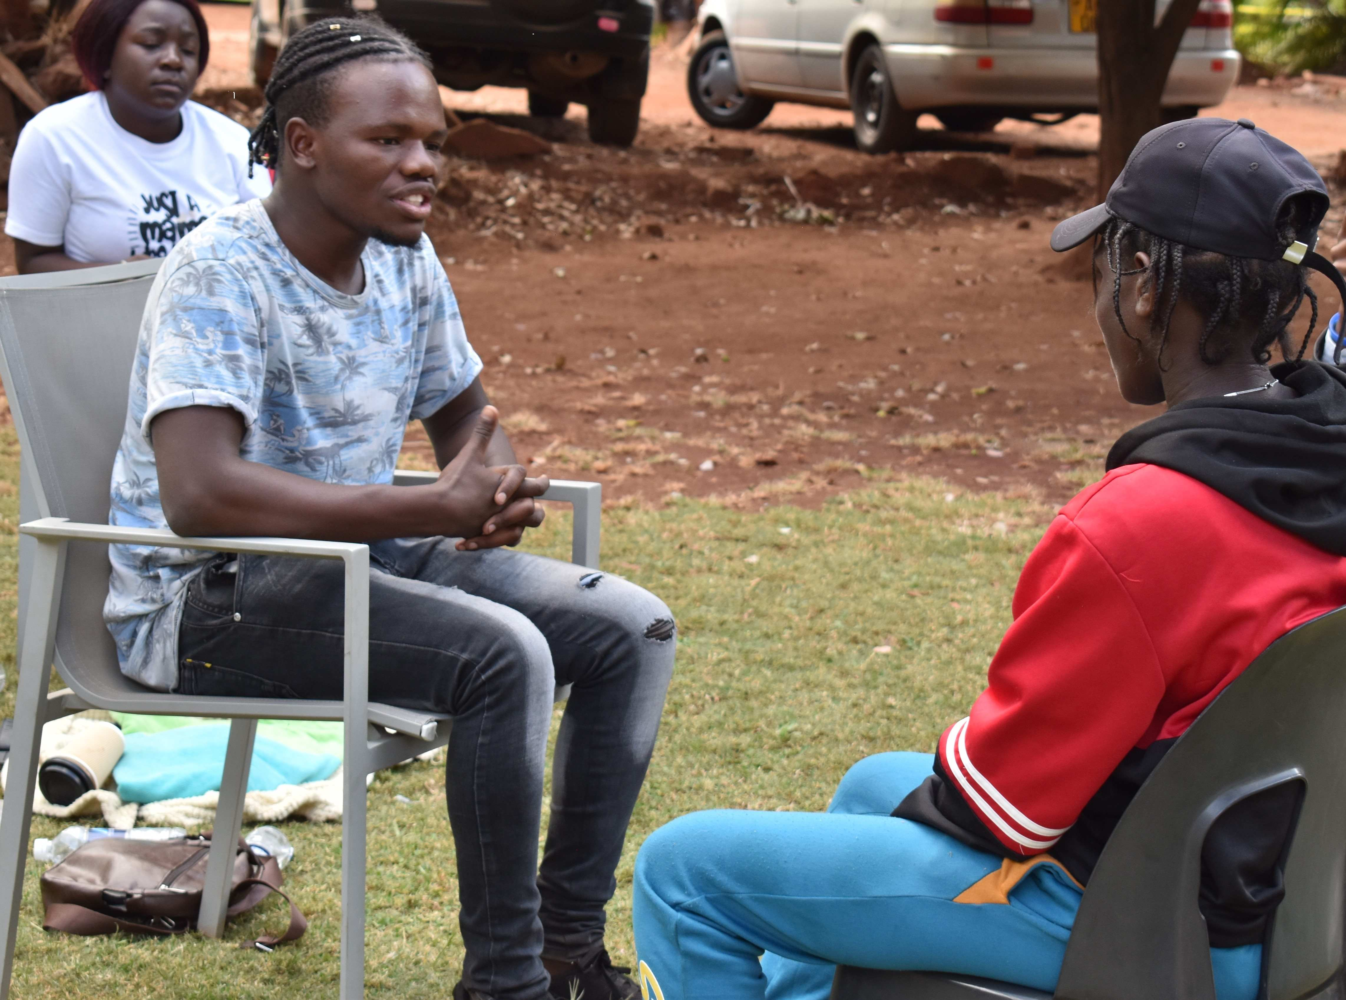
CHALLENGES MOVING FORWARD
Extra days were added for baseline, midline and endline assessments
Held at head office so access to more staff for training than when trainings are conducted in the districts
4 or more facilitators to conduct assessments
To be determined
Integrating EQUIP into standard trainings without additional resources, budget, staffing: learning from 1st attempt
Supervision and mentorship: using EQUIP assessments
Training of staff to conduct assessments

Slide 18
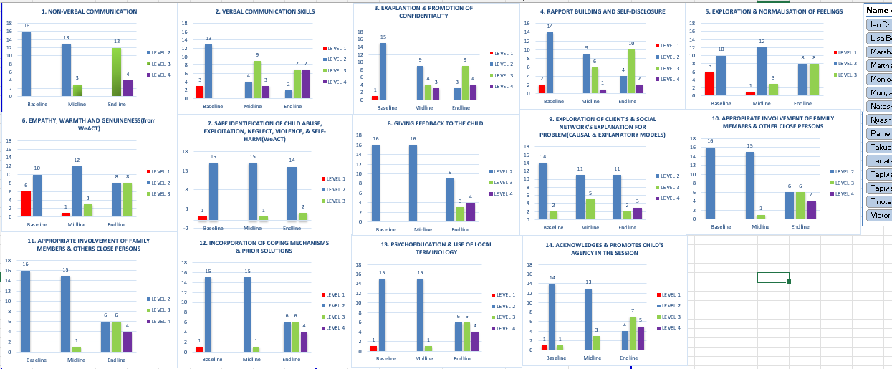
CLIENT DASHBOARD
Notes:
Moving forward- Supervision – can track and focus on specific skills

Slide 19
THOUGHTS AND RECOMMENDATIONS?
Thank you. Tatenda. Siyabonga

